Slide 1
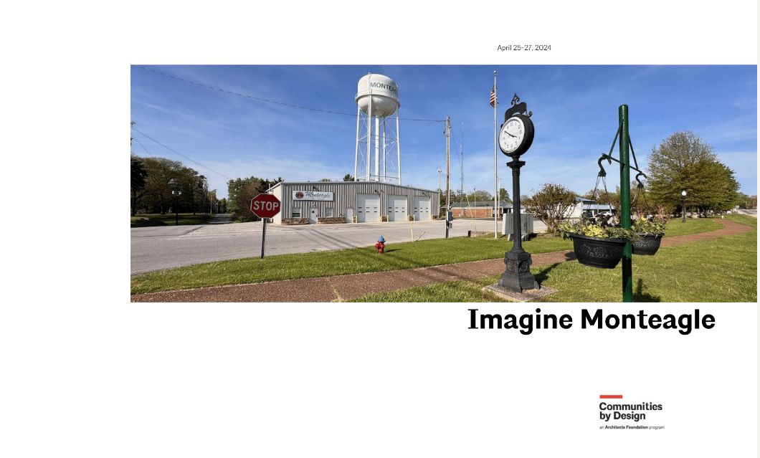

Slide 2
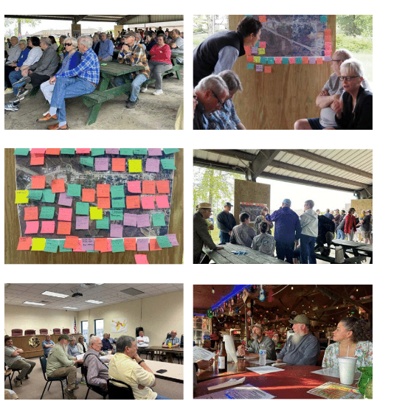
How the plan was put together
Meetings with:
Citizens
Elected Officials
Business Owners

Slide 3
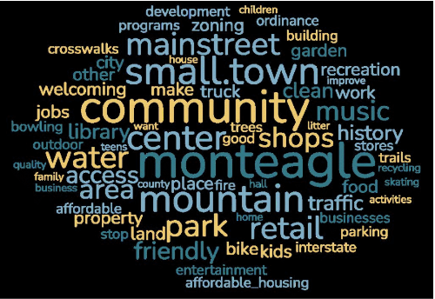
Areas of Focus
Planning and zoning reform
Infrastructure needs
Downtown and Tourist Development
Public Space
Housing

Slide 4
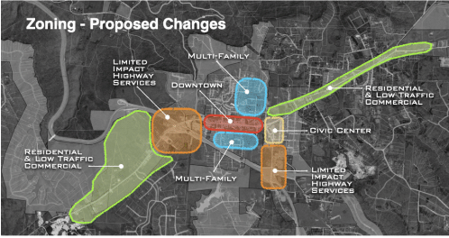
Zoning
Update Zoning map to reflect the Monteagle we want to see.
Improve regulatory framework.
Change zoning districts to promote downtown commercial district.
Add approval criteria for special exceptions
Update subdivision regulations

Slide 5
Conclusion
This plan is an overview that gives options, not prescriptions.
It lays out a series of steps to guide us in several directions.
Adoption will allow us to pursue funding options in areas of interest.
Provides needed direction on growth.
Questions

Slide 6
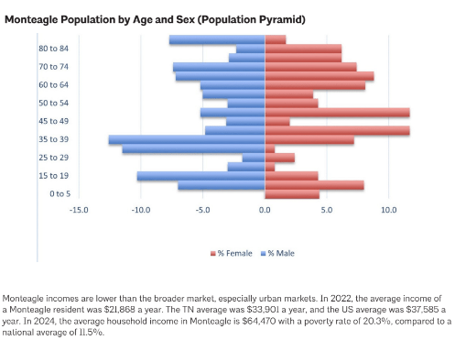
Infrastructure
Complete water rate study
Correct I and I issues with water and sewer
Consider Development impact Fees
Use infrastructure to locate future growth

Slide 7
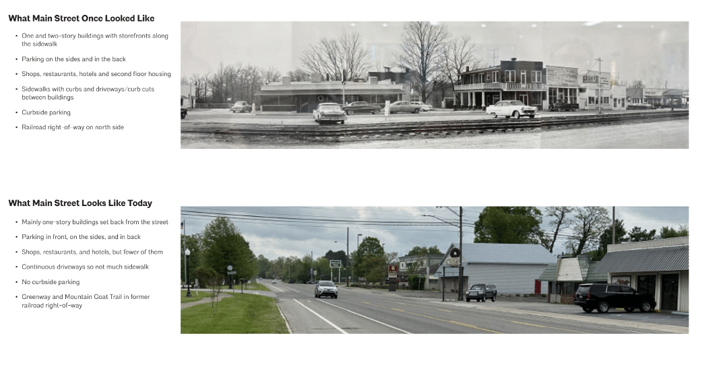
Downtown
Downtown

Slide 8
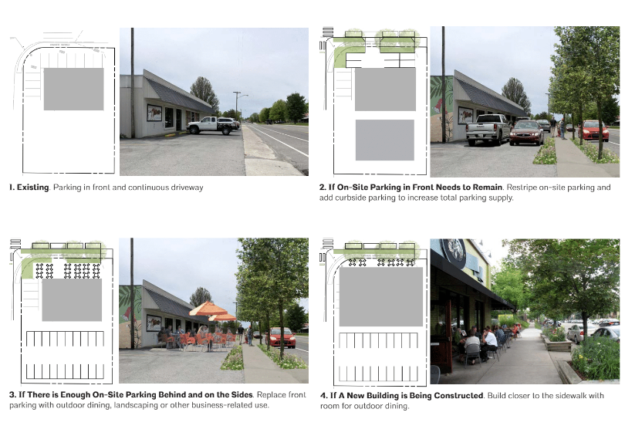

Slide 9
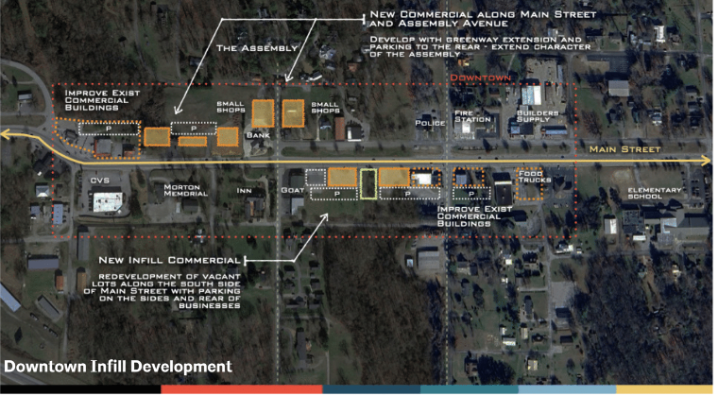

Slide 10
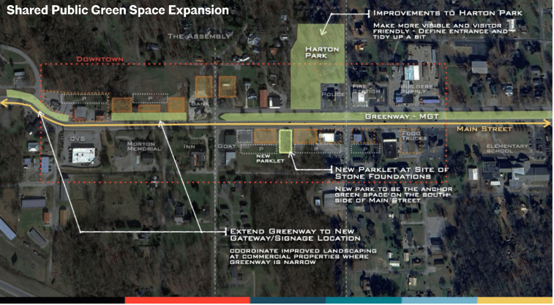
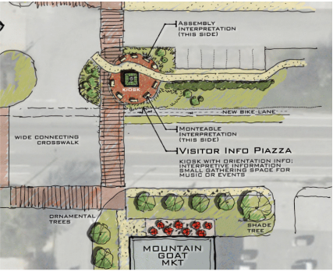
Public Space and Beautification

Slide 11
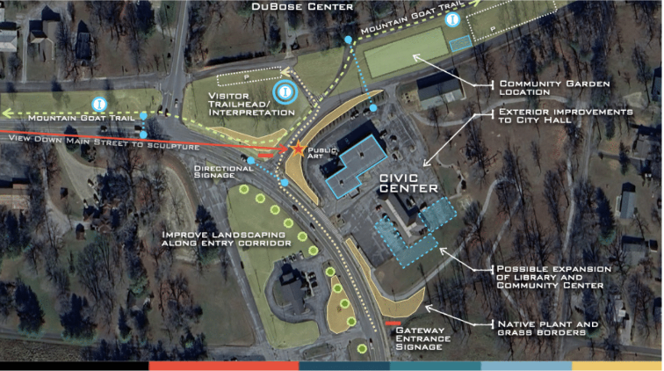

Slide 12
How can you get involved:
Tree Board
Beautification
Public Art
Landscaping
Christmas Celebration
Special Events
Digital presence/website
Economic Development
Resolutions & Ordinances
Grant Writing
Tourism

Slide 13
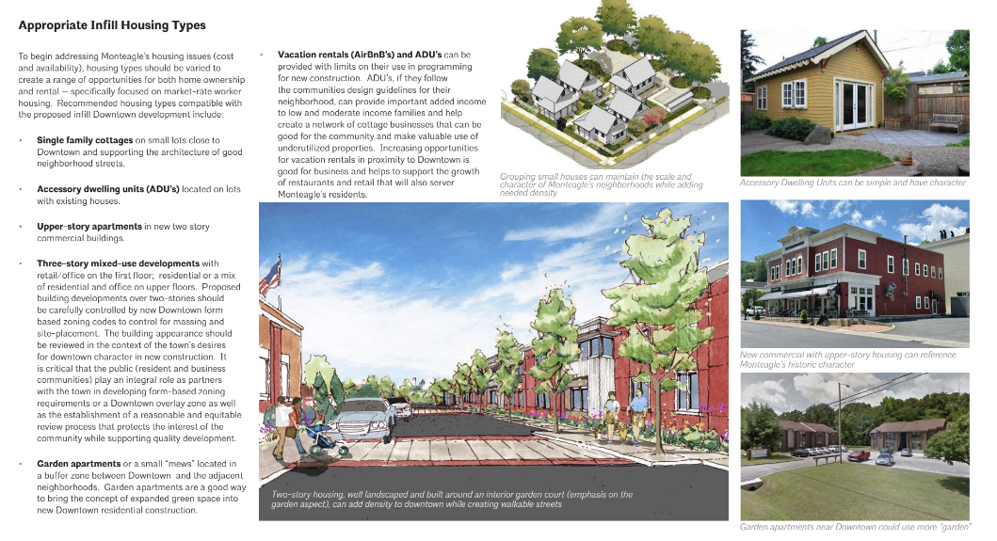
Housing

